Slide 1
Chapter 6 Bipartite variations

Slide 2
Not 1-vertex fault tolerant Hamiltonian
Figure 6-1

Slide 3
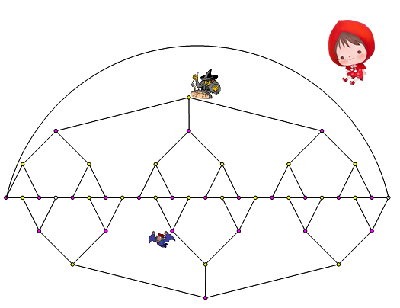
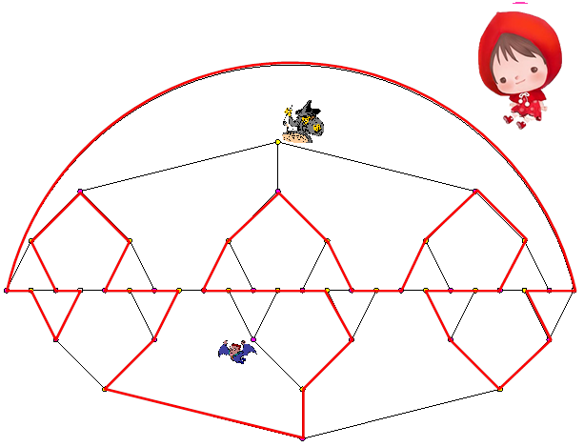
1p-fault tolerant Hamiltonian

Slide 4
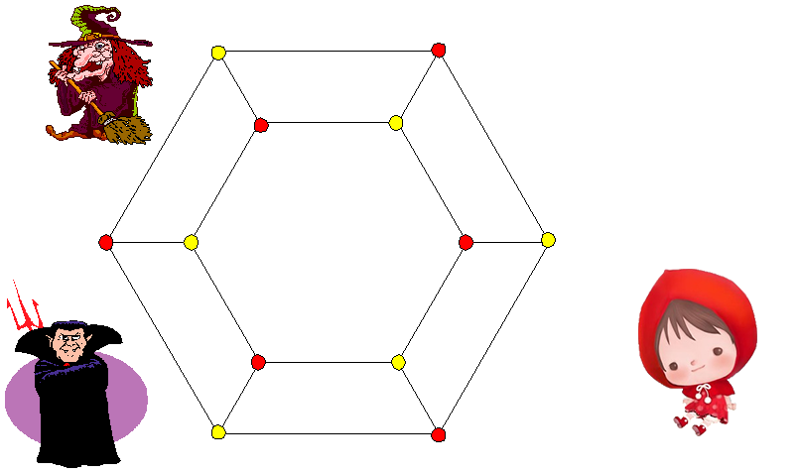
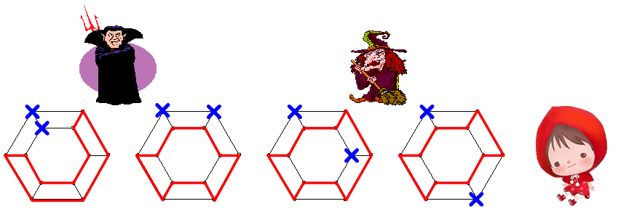

Slide 6
All Category 2 graphs are 1p-fault tolerant Hamiltonian.

Slide 7
How about 3-join?
Figure 6-8

Slide 8
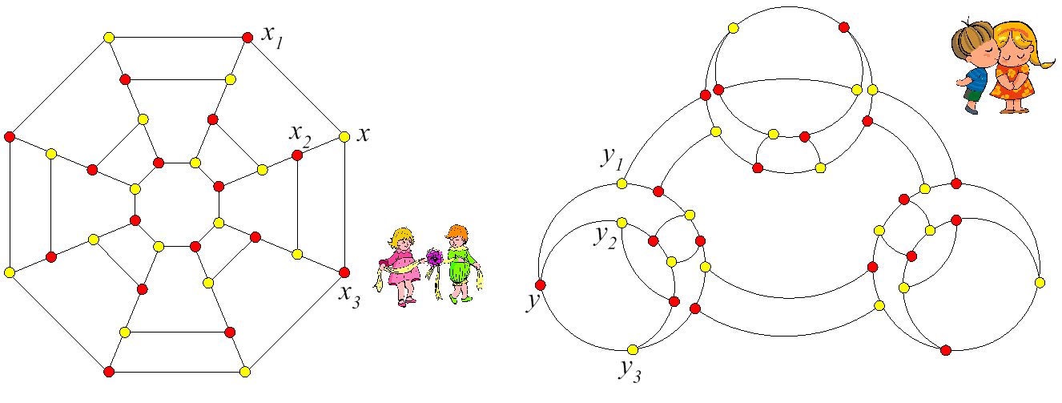
Figure 6-9

Slide 9
Figure 6-10

Slide 10
1-edge fault tolerant Hamiltonian laceable

Slide 11
All graphs in Category 2 are 1-edge fault tolerant Hamiltonian laceable.

Slide 12
Every 1-edge fault tolerant Hamiltonian laceable is 1-edge fault tolerant Hamiltonian.
Figure 6-13

Slide 13
3-join?

Slide 14
Strongly 1-edge fault tolerant Hamiltonian.

Slide 15
All graphs in Category 2 are 1-edge fault tolerant strongly Hamiltonian laceable.

Slide 16
Hyper Hamiltonian laceable

Slide 17
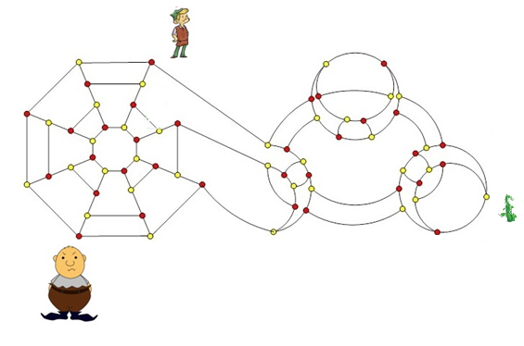
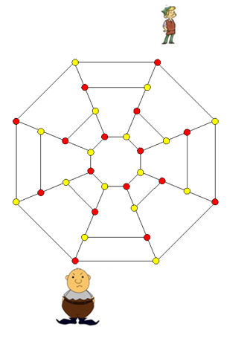
3-join?

Slide 18
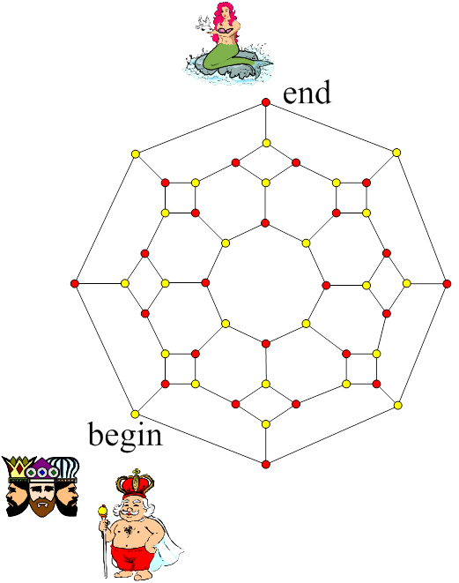
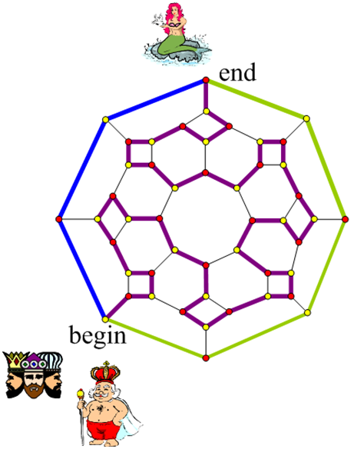
3*-connected puzzle
Figure 6-23

Slide 19
A globally Bi-3*-connected graph is a cubic bipartite graph with three disjoint spanning paths between any two vertices of different color.
All graphs in Category 2 are globally Bi-3*-connected.

Slide 20
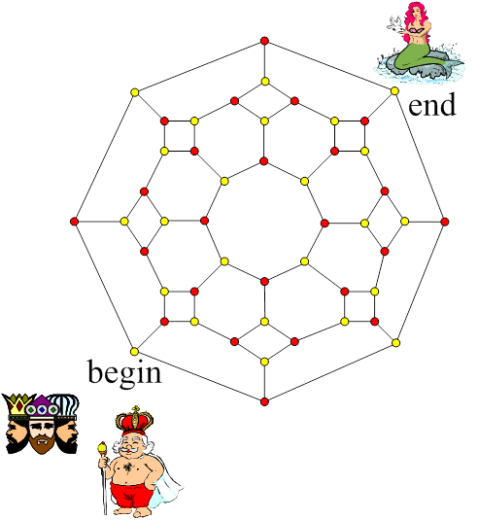
Now, can we solve the same puzzle if the king and mermaid are on two vertices of the same color?

Slide 21
Let us assume that there are three internal disjoint spanning paths, labeled P₁, P₂, and P₃, between the king’s vertex and the mermaid’s vertex. Suppose that there are a_{i} red vertices in P_{i} for i = 1,2,3. If so, there are a_{i} + 1 yellow vertices in Pi for i= 1,2,3. Hence, there are a₁ + a₂ + a₃ red vertices incident with the union of P₁, P₂, and P₃ and there are (a₁ + 1) + (a₂ + 1) +(a₃ + 1)-4 = a₁ + a₂ + a₃-1 yellow vertices incident with the union of P₁, P₂, and P₃. Then, the total number of vertices, both red and yellow, is an odd integer, which results in a contradiction. Thus, the puzzle unable to be solved.

Slide 22
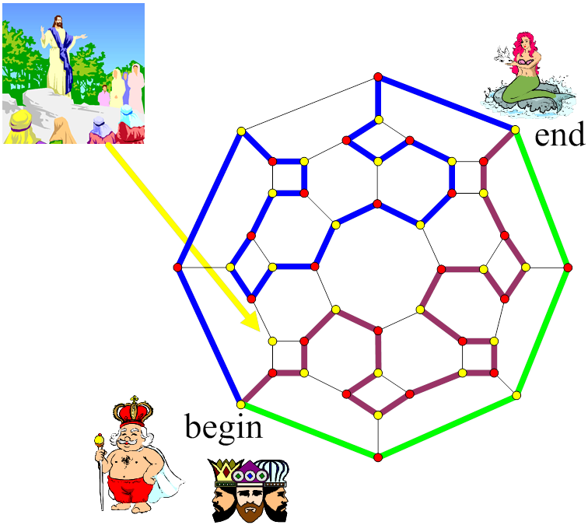
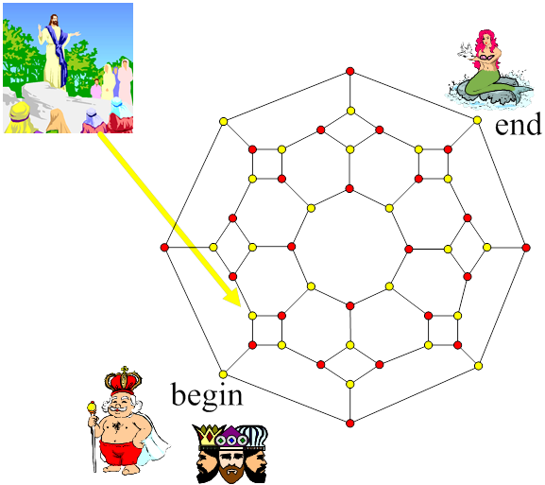
Hyper globally bi-3*-connected.

Slide 23
All graphs in Category 2 are hyper globally Bi-3*-connected.

Slide 24
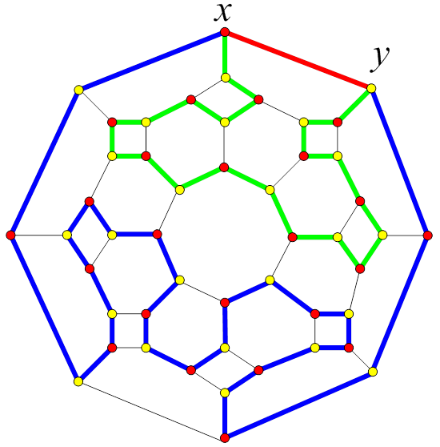
Every globally Bi-3*-connected graph is 1-edge fault tolerant Hamiltonian.

Slide 25
Every hyper globally Bi-3*-connected graph is 1p-fault tolerant Hamiltonian..
Figure 6-29

Slide 27
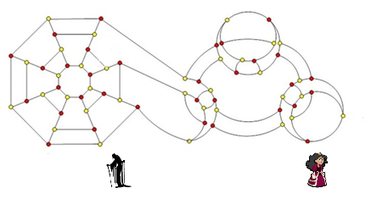
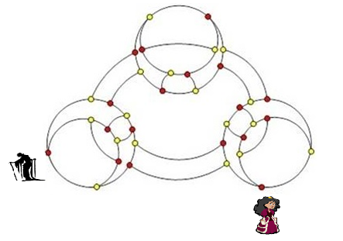
3-join?

Slide 28
Some interesting families.
D₂
D₃
D₄
D₅
With these figures, you can construct D₆, D₇, D₈,…. and so on. It can be demonstrated that D₅₀₀₀ has 10000 vertices and a diameter of 5001.
Diameter: n/2

Slide 29
With this figures, I believe that you can construct SW₄, SW₅, SW₆,…. It can be checked that SW₁₀₀ has 10000 vertices and of diameter 150.

Slide 30
Figure 6-35
With these figures, you can construct HT ₄, HT₅, HT₆,…. and so on. It can be demonstrated that HT₄₁ has 10086 vertices and a diameter of 82.
O(n^{1/2})

Slide 31
Figure 6-36
With these figures, you can construct BT ₄, BT₅, BT₆,…. and so on. It can be demonstrated that BT₁₁ has 12284 vertices and a diameter of 23.
2 log n
It can be shown that B₁₂ is a graph with 12286 vertices and a diameter of 24.

Slide 32
Do we miss anything?

Slide 33
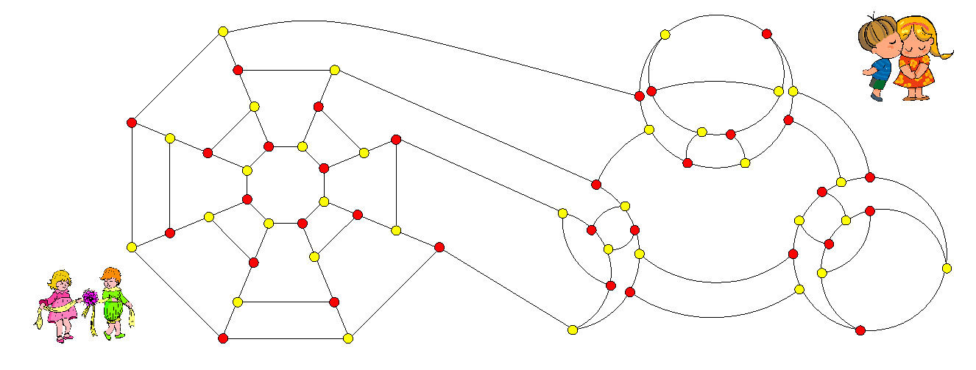
Figure 6-37

Slide 34
Figure 6-37 is obtained by combining the left graph G and the right graph H in Figure 6-38 by the following procedure:
Pick any edge (C,D) of G. Let Z₁ and Z₂ be the two neighbors of C other then D and W₁ and W₂ be the two neighbors of D other then C.
Pick an edge of (A,B) of H. Let X₁ and X₂ be the two neighbors of A other then B and Y₁ and Y₂ be the two neighbors of B other then A.
Delete vertices C and D from G and delete vertices A and B from H.
Join Z₁ and X₁ with an edge, join Z₂ and X₂ with an edge, join W₁ and Y₁ with an edge, and join W₂ and Y₂ with an edge.

Slide 35
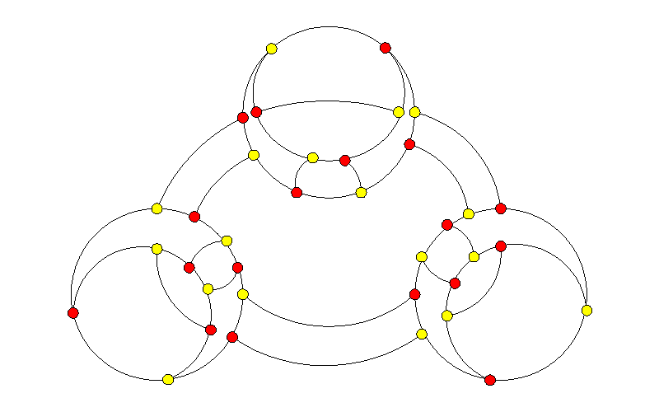
W₁
D
W₂
y₁
C
Z₂
B
y₂
Z₁
X₂
A
X₁
Figure 6-38

Slide 36
We call the resultant graph an edge join of G and H. Note that the edge join shown of G and H is not the only possibility. Different combinations of G and H edges (X₁, X₂, Y₁, Y₂, W₁, W₂, Z₁ and Z₂) will result in different graphs.
Believe it or not, you may perform an edge join on any two graphs in Category 2. Any two Category 2 graphs joined by edge join will be a new Category 2 graph. This is already interesting but there are other significant details worth noting.
First, please check that the graph in Figure 6-39 is Hamiltonian connected, 1-fault tolerant Hamiltonian, and globally 3*-connected.

Slide 37
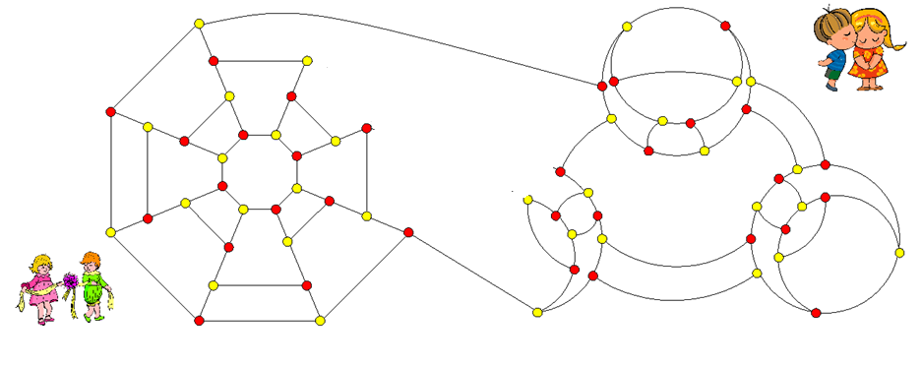
Figure 6-39

Slide 38
Figure 6-39 is obtained by combining the left graph G and the right graph H in Figure 6-38 by the following procedure:
Pick any edge (C,D) of G. Let Z₁ and Z₂ be the two neighbors of C other then D and W₁ and W₂ be the two neighbors of D other then C.
Pick an edge of (A,B) of H. Let X₁ and X₂ be the two neighbors of A other then B and Y₁ and Y₂ be the two neighbors of B other then A.
Delete vertices C and D from G and delete vertices A and B from H.
Join Z₁ and X₁ with an edge, join Z₂ and Y₂ with an edge, join W₁ and Y₁ with an edge, and join W₂ and X₂ with an edge.
As you can see, the resulting graph is identical to Figure 6-37, except for two switched edges. Moreover, since the graph in Figure 6-39 is not bipartite, we color all its vertices with the same color.

Slide 39
We call the resultant graph an edge twist of G and H. Again, the edge twist shown of G and H is not the only possibility. Different combinations of G and H edges (X₁, X₂, Y₁, Y₂, W₁, W₂, Z₁ and Z₂) will result in different graphs.
Believe it or not, you may perform an edge twist on any two graphs in Category 2. Any two Category 2 graphs joined by edge join will be a new Category 1 graph.
Roughly speaking, we need formal discussion

Slide 40
Take any super graph. Say spider web network S(6,4)

Slide 41
Replace any edge into 4 cycle

Slide 42
Graph A
Graph B

Slide 43
Graph A: Edge join with K _{3,3}
Graph B: edge twist with K _{3,3}

Slide 45
Shrink all 4 cycles
Replace some edge with4 cycles
Shrink some 4 cycles
Replace some edge with4 cycles
K _{3,3}

Slide 46
Take any path of length 3. (Yellow path)
Bisect the edges by insert purple vertices.
Joins purple vertices with the extra red vertex.
Actually edge twist with Q ₃

Slide 47
Replace the edge
with
Equivalent to edge join with Q ₃.

Slide 48
Another layout
Edge join with Q ₃
Repeated operation

Slide 50
Not 1-edge fault tolerant Hamiltonian laceable

Slide 51
Not hyper Hamiltonian laceable

Slide 52
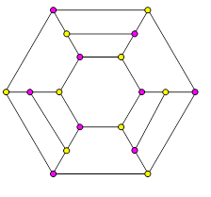
Not 1p-fault tolerant Hamiltonian

Slide 53
Globally Bi-3*-connected.
Strongly globally Bi-3*-connected.
Not hyper globally Bi-3*-connected

Slide 54
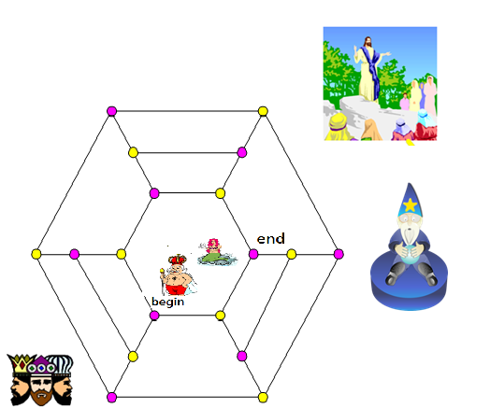
Pray again. God listen

Slide 55
Suggested Reading and Possible Future Directions
The issue of whether graph G is Hamiltonian or Hamiltonian connected is important. Any Hamiltonian bipartite graph has the same number of vertices in each partite set because the vertex colors of the bipartite path alternate. This means that not all Hamiltonian bipartite graphs are Hamiltonian-connected. Simmons [6] introduced the concept of Hamiltonian laceability for those Hamiltonian bipartite graphs. A Hamiltonian bipartite graph G is Hamiltonian laceable if there is a Hamiltonian path between any two vertices x and y, when x and y are in different partite sets. Hsieh et al. [1] further extended this concept to strongly Hamiltonian laceable graphs. A Hamiltonian laceable graph G is strongly laceable if there is a simple path through all but one vertex of G.

Slide 56
Lewinter et al. [5] introduced the concept of hyper Hamiltonian laceable. A hyper Hamiltonian laceable graph is a Hamiltonian laceable graph with a fault free Hamiltonian path between any two vertices of the same color when one vertex of the different color is faulty. Tsai et al. [9] began the study of 1-edge fault tolerant Hamiltonian laceability and 1-edge fault tolerant strongly Hamiltonian laceability of bipartite graphs. Kao and Hsu [2] introduced the concept of 1p-fault tolerant Hamiltonian. Later, the concept of globally 3*-connected graphs and hyper globally Bi-3*-connected graphs was introduced [4].

Slide 57
There is also another concept, called strongly globally 3*-connected graphs introduced. A globally bi-3*-connected graph G is strong if for any two different vertices x and y in the same partite set of G, there exists a vertex z of the same partite set as the one that contains x and y such that there exist three internal disjoint spanning paths of G-{z} joining x to y. Obviously, any globally bi-3*-connected is strong if it is hyper.

Slide 58
It can be checked that D_{k} has 2k vertices and of diameter k+1. Stojmenovic [7] introduced the family of graphs H_{k}. This family of graphs is called honeycomb torus and it has a lot of applications in communication. It can be checked that HT_{k} has 6k² vertices and of diameter 2k. It is interesting to point out H_{k} is isomorphic to the generalized Honeycomb torus GHT(k,6k,3k). Kao et al. [3] introduced the graph SW_{k} called the spider web network which is a planar variation of the honeycomb torus. It can be checked that the spider web network SW_{k} has k² vertices and of diameter 3k. The brother tree graphs BT_{k} was introduced by Kao et al. [2]. It can be demonstrated that BT_{k} has 6×2^{k}-4 vertices and of diameter 2k+1. Further discussion of edge joins and edge twists will appear in forthcoming literature.

Slide 59
For possible future directions, we can classify the 1p-fault tolerant Hamiltonian, Hamiltonian laceability properties, and the globally bi-3*-connected properties of some families of graphs. For example, it is proven by Kao and Hsu [2] that any brother tree BT(n) is 1-edge fault tolerant Hamiltonian and 1p-fault tolerant Hamiltonian. Kao and Hsu also prove that the generalized Petersen graph GP(n,1) is hyper globally 3*-connected if n is even with n≥4 [4]. Teng, Tan, and Hsu proved that the generalized Honeycomb torus GHT(m,n,0) is strongly globally 3*-connected if m and n are positive even integers with n ≥4. Moreover, the generalized Honeycomb torus GHT(m,n,0) is hyper globally 3*-connected if and only if m and n are even with n ≥6 or m=2 [8]. For cube-connected cycles, we hypothesize that CCC_{n} is globally 3*-connected if and only if n is odd with n ≥ 5

Slide 60
References
S.Y. Hsieh, G.H. Chen, and C.W. Ho, “Hamiltonian-laceability of star graphs,” Networks 36 (2000) 225–232.
S.S. Kao, and L.H. Hsu, “Brother trees: A Family of Optimal 1p-Hamiltonian and 1-Edge Hamiltonian Graphs,” Information Processing Letters, 86 (2003), 263-269.
S.S. Kao, and L.H. Hsu, “Spider Web Networks: a Family of Optimal, Fault Tolerant, Hamiltonian Bipartite Graphs,” Applied Mathematics and Computation, 160 (2005), 269-282.
S.S. Kao, H.C. Hsu, and L.H. Hsu, “Globally bi-3*-connected graphs,” Discrete Mathematics, 309, 2009, 1931-1946.
M. Lewinter, W. Widulski, “Hyper-Hamilton laceable and caterpillar-spannable product graphs,” Comput. Math. Appl. 34 (1997) 99–104.

Slide 61
G. Simmons, “Almost all n-dimensional rectangular lattices are Hamilton laceable,” Congr. Numer. 21 (1978) 103–108.
Stojmenovic, “Honeycomb networks: topological properties and communication algorithms,” IEEE Transactions on Parallel and Distributed Systems 8 (1997) 1036–1042.Y.H.
Teng, J.J.M Tan, and L.H. Hsu, “The Globally Bi-3*-connected property of the Honeycomb Rectangular Torus,” Information Sciences, 177, (2007), 5573-5589.
C.H. Tsai, J.M. Tan, T. Liang, and L.H. Hsu, “Fault-Tolerant Hamiltonian Laceability of Hypercubes,” Information Processing Letters, 83 (2002), 301-306.

